Slide 1

TEAM NODE WARRIORS: JADA W. JACINTA O. ANTONIO P. CORNELIUS H.
Notes:
JACINTA:
Introduction and project intro

Slide 2

TRANSFORMING PAYMENTS IN TRAVEL
Notes:
Cornelius

Slide 3

THE CURRENT SITUATION
Customer pay travel agents in advance for future travel
The Travel agent is placed in “TRUST”
There are situations where a consumer often is not aware that the actual supplier has not received their funds.
Covid-19 has highlighted these issues through “double dipping blind spots”,
There is a need for greater Trust and Transparency within the Travel Echo-Chain
Notes:
Overview and Issue - Cornelius:
1. Customer / corporations / Tour Operators / Sport Teams / Governments - pay travel agents in advance for future travel these bookings include ancillary fees, hotel, car rentals, tours, activities, shows, special reservations etc. all paid to a “centralized entity” (The Agency) entrusted to make payment to others.
2. Travel agent is placed in “trust” of all moneys until suppliers need to be paid (depends on specific SLA’s and timelines)
Agents use this liquidity to run their business (even though they are not allowed to do that).
Both IATA and ARC clearly states “… the agent is to hold the moneys in trust, on behalf of the airlines. It is advisable to have a dedicated bank account for the same.
There is a risk in a 3rd party being entrusted with a large amount of funds and “unlimited credit” (in the form of e-ticket stock) without any true rules & oversight
This risk affects:
The consumer
Agents
Banks and Card Brands
Downstream operators and,
Airlines
3. There are situations where a consumer often is not aware that the actual supplier has not received their funds and could be placed in a position of having to pay again, without any accountability being leverage on the agent.
In some instances, agents, airlines & tour operators could go out of business leaving the traveler stranded or needing to refund their trip.
Where the form of payment is credit cards the financial institutions and card brands are also affected as they are the ones having to mange the subsequent chargebacks and related risks.
Covid-19 has highlighted these issues through “double dipping blind spots”,
continues policy changes of airlines and the need for cash flow restricting refunds and opting for future travel or travel credit. ----- some consumers don’t want this

Slide 4
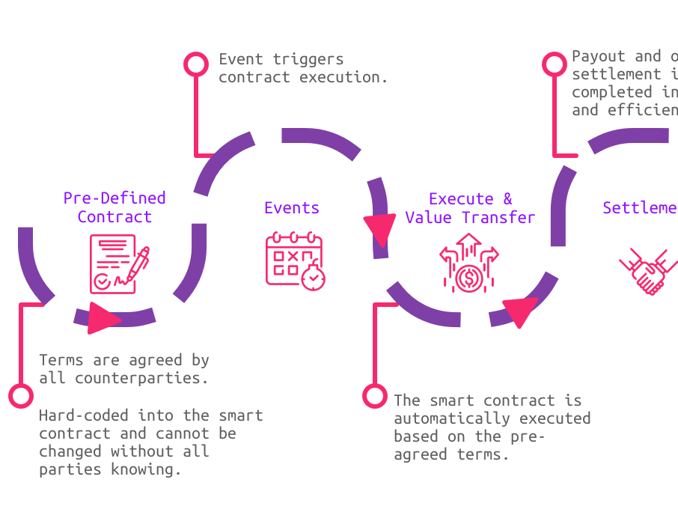
PROPOSED SOLUTION: SMART CONTRACTS
SMART contracts between Consumer/Travel Agent and Supplier
The SMART contract ingest all the data related to the trip
A Escrow operates as the TRUST with SMART rules.
Building a SMART and TRUSTED value chain
Notes:
Overview and high-level concept - Cornelius:
Our objective was to uitlize what we learned in during the bootcamp in order to develop a new environment of trust using Smart contracts managing the flow of funds between Consumer/Travel Agent and Supplier 1/2/3/4/5
The objective is that the smart contract ingest all the relevant information for a specific trip:
Confirmation of booking
Segment information (flight, hotel, car rental, etc.)
Supplier information
Service(s) deliverables
Payment dates & amounts for all segments
Creating a SMART and TRUSTED value chain.
Over to JADA to describe our process.

Slide 5


REMIX / SOLIDITY
Contracts Evaluated
OWNABLE
PAYMENT SPLITTER
PULL PAYMENT
ESCROW
CONDITIONAL ESCROW
REFUND ESCROW
ERC721
Notes:
Jada – present on the code
owner function / sender to be the travel agent - Using ownable.sol
Payment Piece - customer makes payment to agent or to the 3rd Party Escrow directly, using credit card, crypto etc.
if the customer makes payment to the Agent. The Agent funds the 3rd Party escrow
The 3rd Party Escrow is linked to the Smart Contract and is the initiator and distributor of funds to the value chain participants.
The Escrow is established with set conditions per the Smart Contract terms. To support this we are using ConditionalEscrow.sol.
(Pull Payment) Deposit to the four accounts
Refund Escrow when services are not delivered / cancelled or changes are made to the travel.
Rules for when funds are to be sent, date / time / delivery etc. We are proposing TimelockController. //Segment information??- flight, hotel, car, rental etc.
A contract is initiated between Customer and the value chain.
(Pull Payment) Deposit to the four accounts

Slide 6
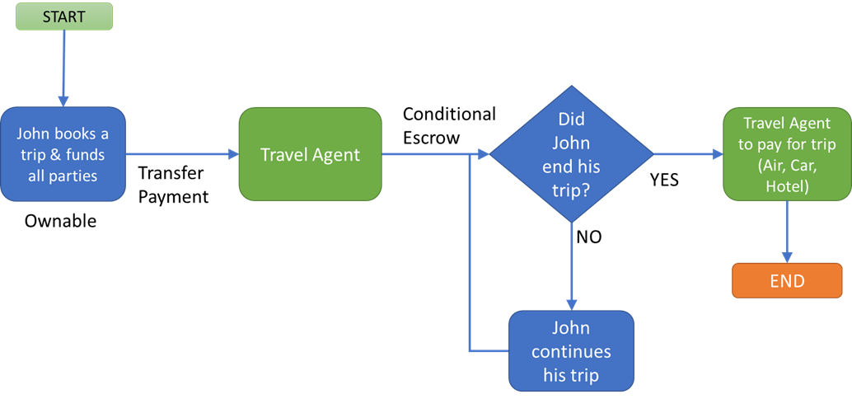
REMIX / SOLIDITY
Contracts Evaluated
OWNABLE
PAYMENT SPLITTER
PULL PAYMENT
ESCROW
CONDITIONAL ESCROW
REFUND ESCROW
ERC721
First Approach Workflow
Notes:
Jada – present on the code
owner function / sender to be the travel agent - Using ownable.sol
Payment Piece - customer makes payment to agent or to the 3rd Party Escrow directly, using credit card, crypto etc.
if the customer makes payment to the Agent. The Agent funds the 3rd Party escrow
The 3rd Party Escrow is linked to the Smart Contract and is the initiator and distributor of funds to the value chain participants.
The Escrow is established with set conditions per the Smart Contract terms. To support this we are using ConditionalEscrow.sol.
(Pull Payment) Deposit to the four accounts
Refund Escrow when services are not delivered / cancelled or changes are made to the travel.
Rules for when funds are to be sent, date / time / delivery etc. We are proposing TimelockController. //Segment information??- flight, hotel, car, rental etc.
A contract is initiated between Customer and the value chain.
(Pull Payment) Deposit to the four accounts

Slide 7
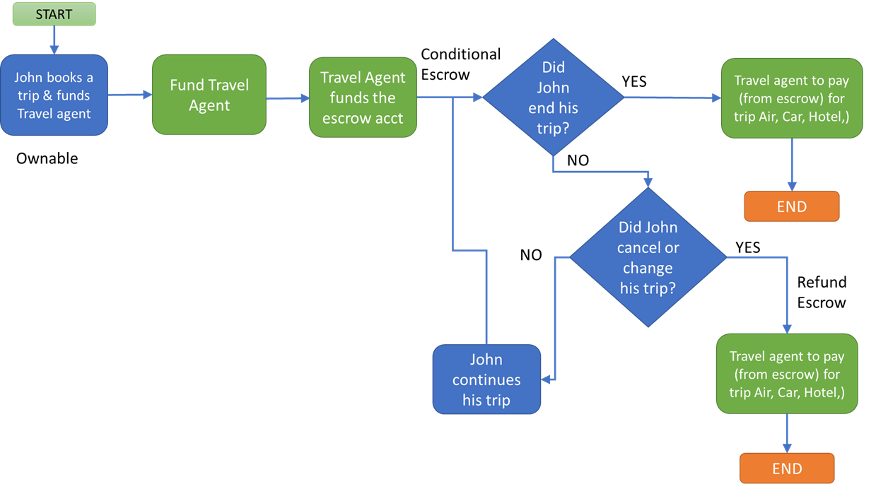
REMIX / SOLIDITY
Contracts Evaluated
OWNABLE
PAYMENT SPLITTER
PULL PAYMENT
ESCROW
CONDITIONAL ESCROW
REFUND ESCROW
ERC721
Second Approach Workflow
Notes:
Jada – present on the code
owner function / sender to be the travel agent - Using ownable.sol
Payment Piece - customer makes payment to agent or to the 3rd Party Escrow directly, using credit card, crypto etc.
if the customer makes payment to the Agent. The Agent funds the 3rd Party escrow
The 3rd Party Escrow is linked to the Smart Contract and is the initiator and distributor of funds to the value chain participants.
The Escrow is established with set conditions per the Smart Contract terms. To support this we are using ConditionalEscrow.sol.
(Pull Payment) Deposit to the four accounts
Refund Escrow when services are not delivered / cancelled or changes are made to the travel.
Rules for when funds are to be sent, date / time / delivery etc. We are proposing TimelockController. //Segment information??- flight, hotel, car, rental etc.
A contract is initiated between Customer and the value chain.
(Pull Payment) Deposit to the four accounts

Slide 8


Next Steps:
Dispute Resolution
3rd_Party_Arbitration
Payment
Ruling?
Y
Create
Dispute
Issue?
Arbitration
Deny
Need smart contract to resolve disputes over service
No current ERC to address issue
ERC 792 Arbitration Standard proposal submitted by Kleros 2017
N
Accept
Arbitration
Appeal
Execute
Payment
Final
Ruling
Notes:
-The ERC is about rulings and enforcement; an arbitration standard allows interoperability between dapps needing and requiring arbitration.
-Using two contracts would allow separation between the ruling and its enforcement.

Slide 9

ISSUES / HURDLES
Funding Accounts
Initiating Transactions
Finding OpenZepplin contracts to suit our concept
Complexity of the concept
Notes:
Need to properly setup testing framework to deploy and use contracts. We were slowed by funding accounts with ETH.
Determining proper flowpath of contracts
Proper build: Importing support contracts from open source vs. putting all functions in one contract
Having time and expertise to flesh out all complexities of model

Slide 10
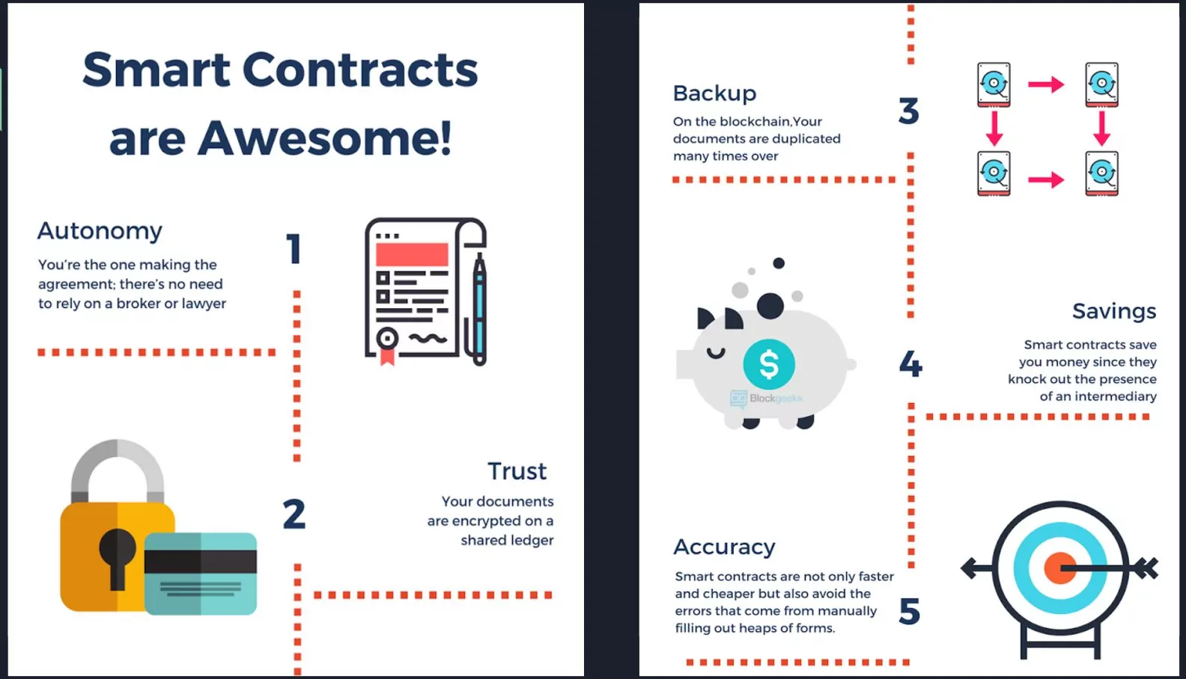
BENEFITS & SUMMARY
Agents
Card brands / banks are not left holding the bag
Build Confidence
Notes:
Perceived benefit proposition – Jacinta
Agents:
Avoid situations like Covid where TA's are "stuck" between customer and supplier
Minimize risk associated with business failures – not all funds would have been distributed before the full service was provided.
Prevent the possibility of Double Refunds to customers who historically might have been caught up in the dispute between business and eventually triggering the CB
Back-office cost reduction
Card brands / banks are not left holding the bag:
Money flows within set controls.
Communication (system integrated) is real time.
No confusion; if a CB was generated & paid, refund issued, future date travel accepted, coupon accepted, hotel stay, or car rental credit received & accepted etc.
Build Confidence:
They know they will get what they paid for or they will get their money back (no-one in the value chain, takes significant loss).
If something goes wrong customer is not left to pay twice
Generate more trust between Consumer - OTA - Cruise lines – Tour Operators – Hotels – Car Rental - Suppliers
We are a "Trusted 3rd party" that act as the gateway, payment processor and debit agent to release funds once a service has been provided.
We can also act as a conduet for the Traditional Clearing house models such as the BSPs and ARC.
Agents generating a service fee or getting commissions for bookings will receive funds inline with existing agreements. Inline with those funds due to them.

Slide 11


Slide 12
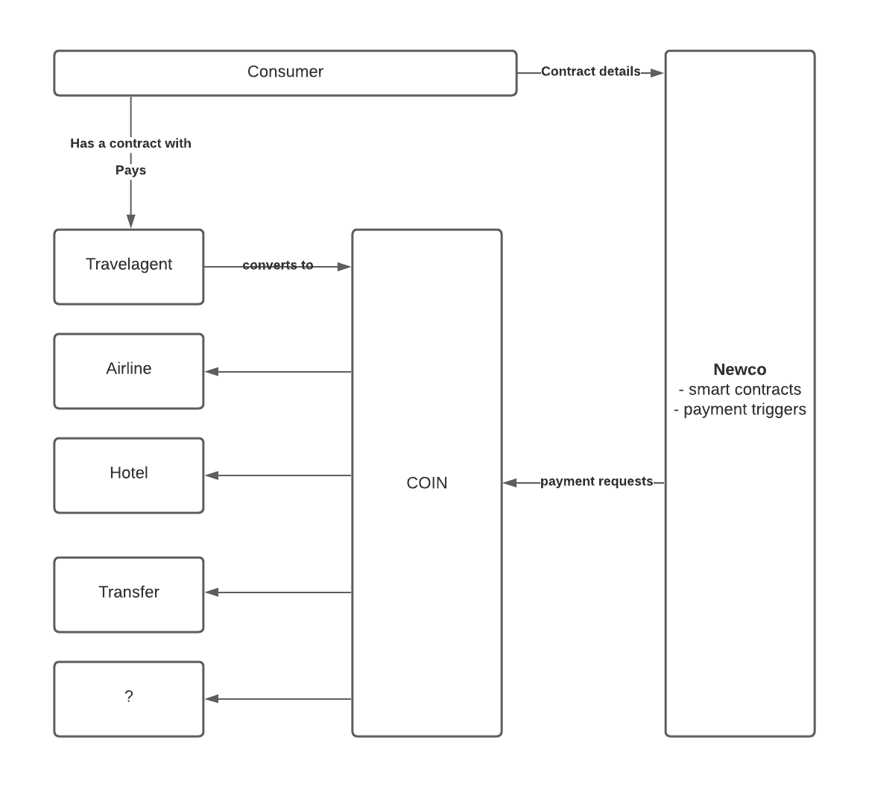
WHAT IS THE CONCEPT? – NEW SOLUTION
John Smith Traveler
ESCROW

